Slide 1
The HEC
HEC = High End Computing
This presentation is based on the guide provided by the HEC of which this contains more details if wanted:
https://answers.lancaster.ac.uk/display/ISS/High+End+Computing+%28HEC%29+help

Slide 2
What is the HEC?
Consists of:
1 login node -> The computer that is used when you login. This is slow and should not be used for any tasks other than monitoring or assigning jobs really.
CPU nodes -> ~445
GPU nodes -> 2
All computers/nodes are Linux based:
Good resource for learning Linux: https://robinlong-tutorials-linux.readthedocs.io/en/latest/introduction.html

Slide 3
What is the HEC?
CPU Nodes (~445):
~300 single core nodes with between 4 and 8GB of memory.
Various 16 core nodes with between 64 and 128GB of memory. At least 8 of these nodes.
At least 17 40 core nodes with 192GB of memory.
2 GPU nodes each containing:
3 Nvidia V100 32GB, 32 CPU cores, 192GB memory.

Slide 4
Get access?
First you need to get a login, ask your PI/Supervisor to apply for an account. See here for more details: https://answers.lancaster.ac.uk/display/ISS/Get+access+to+the+HEC
Once you have a login access via ssh using Lancaster login:
ssh username@wayland.hec.lancaster.ac.uk
See here for more details for login (windows): https://answers.lancaster.ac.uk/display/ISS/Logging+in+to+the+HEC

Slide 5
File store/File quota
Home -> 10GB -> Backup nightly -> Permanent -> $HOME
Storage -> 100GB -> No Backup -> Permanent -> $global_storage
Scratch -> 10TB -> No Backup -> Deleted after 4 weeks -> $global_scratch
Temp -> Unlimited -> No Backup -> Only exists when the job is running -> $TMPDIR
NOTE: $TMPDIR environment variable only exists when the job is running all others exist on the login node

Slide 6

File store/File quota
To check the amount of storage used run: `gpfsquota`:

Slide 7

File store/File quota
The 10TB of scratch area is really useful! However files will be deleted end of day if last modified time is 4 weeks old. Therefore when using the scratch make sure to update the last modified time if you want the files to be kept.
This simple bash script will update all files in the given directory ($1) recursively. (This should be fine to run on the login node).
Bash script can be found in this link

Slide 8
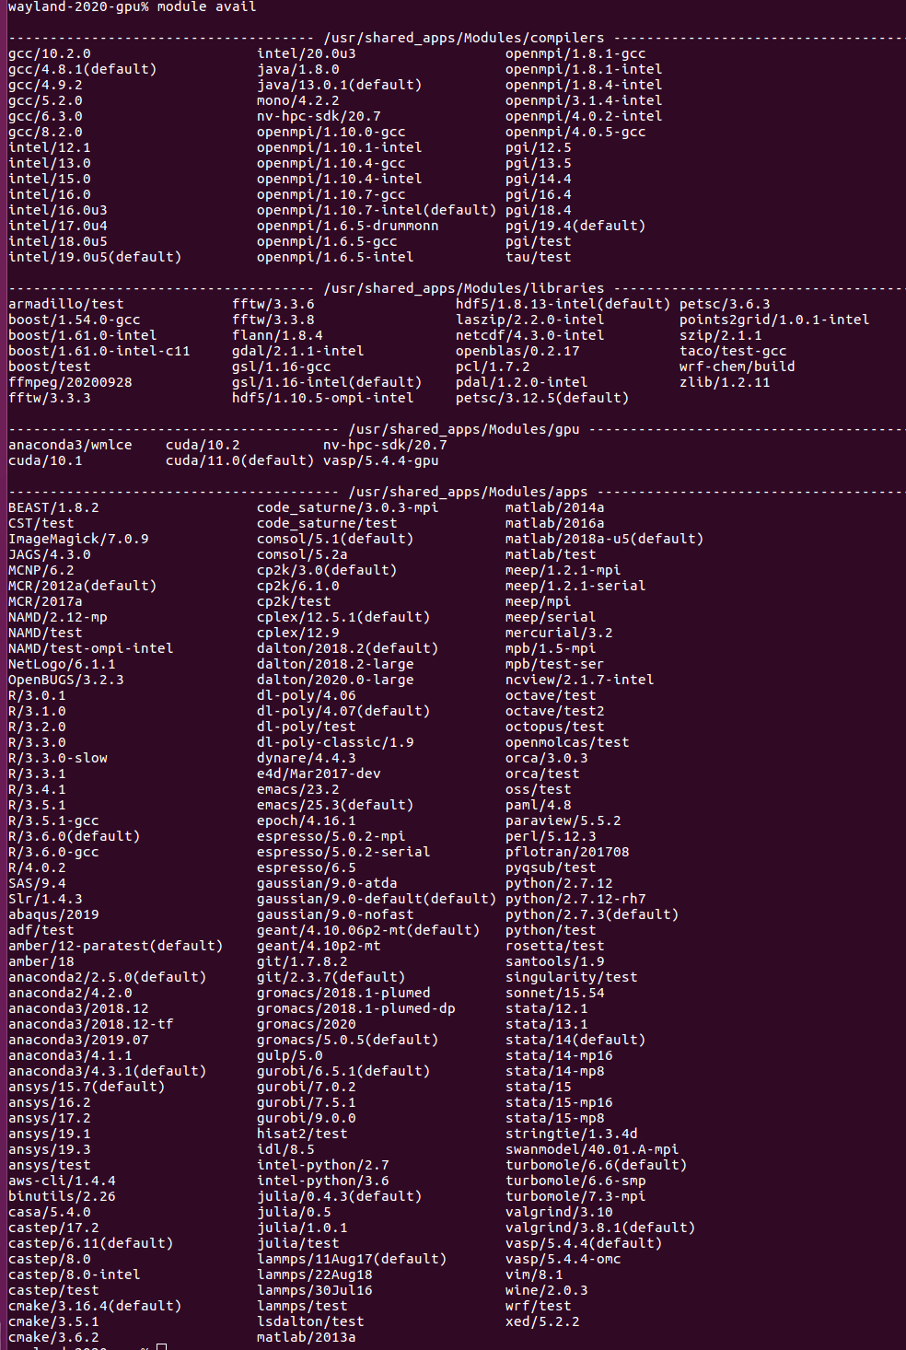

Installing Software
Pre-installed software: `module avail`

Slide 9
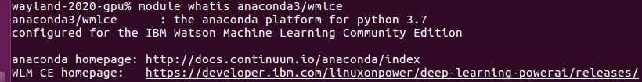
Installing Software
`module whatis anaconda3/wmlce`:
`module add anaconda3/wmlce`
`module list` -> lists all software currently being used.
More details about what that package is doing run:
`module show anaconda3/wmlce`

Slide 10
Anaconda3/wmlce package
`conda --version` -> conda 4.8.2 came out 24/1/2020
`conda list` shows what packages have been installed
`source activate wmlce_env` will use all of the packages that is associated with the `wmlce_env` environment. This includes Tensorflow etc.

Slide 11
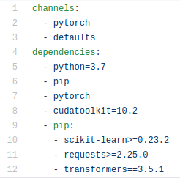
Your own conda environment
Still need to use the anaconda3/wmlce, as we need conda.
We need to specify what we want to install via an environment file like so:

Slide 12
Your own conda environment
`conda install pytorch cudatoolkit=10.2 -c pytorch`

Slide 13
Your own conda environment
The defaults/main channel channel for Linux and others:

Slide 14
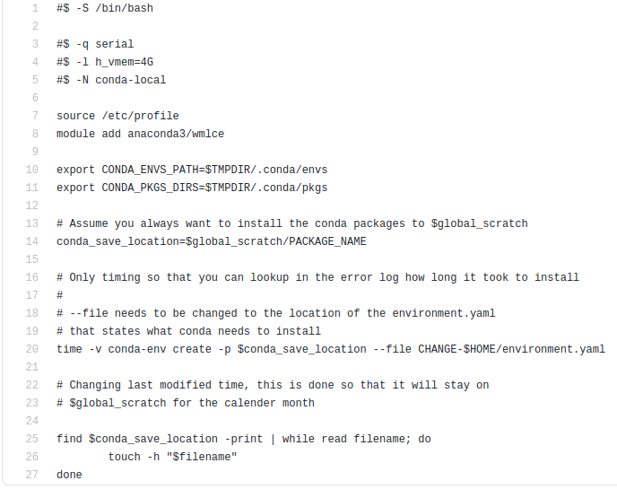
Your own conda environment
Serial – single CPU node
-l – 4GB memory
-N – name of job
File can be found here

Slide 15
Useful commands for running jobs
Jobs can be run with the `qsub` command e.g. `qsub install.com`
Check number of free slots `qslots`
Check status of jobs `qstat`
Check CPU/Memory usage of jobs `qtop -u USERNAME` e.g. `qtop -u moorea`
Check amount of resources used and are allowed to used (only applicable to CPU nodes) `qquota` LIMITED to 350 cores and 1.64TB memory

Slide 16
GPU Example
2 GPU nodes each containing:
3 Nvidia V100 32GB, 32 CPU cores, 192GB memory.
This is broken up mainly into GPUs e.g. 6 GPUs of which if you want to use multiple GPUs a hardware limit of 3 is applied.
LIMITATION -> Only allowed to use a GPU node for 12 hours, but could use 3 GPUs for 12 hours ~ 1 GPU for 36 hours.

Slide 17
GPU Example
Given that we installed the requirements using the last example:

Slide 18
GPU Example
#$ -S /bin/bash
#$ -q gpu
#$ -l ngpus=1
#$ -l ncpus=4
#$ -l h_vmem=40G
#$ -l h_rt=00:25:00
#$ -N run-transformer-model
source /etc/profilemodule
add anaconda3/wmlce
# Activate conda package from where it was saved.
source activate $global_scratch/PACKAGE_NAME
python ./bert_model.py ./data/train.tsv ./data/dev.tsv ./data/test.tsv ./data/emotions.txt $global_scratch/models/saved_model.pt --cuda --batch-size 16

Slide 19
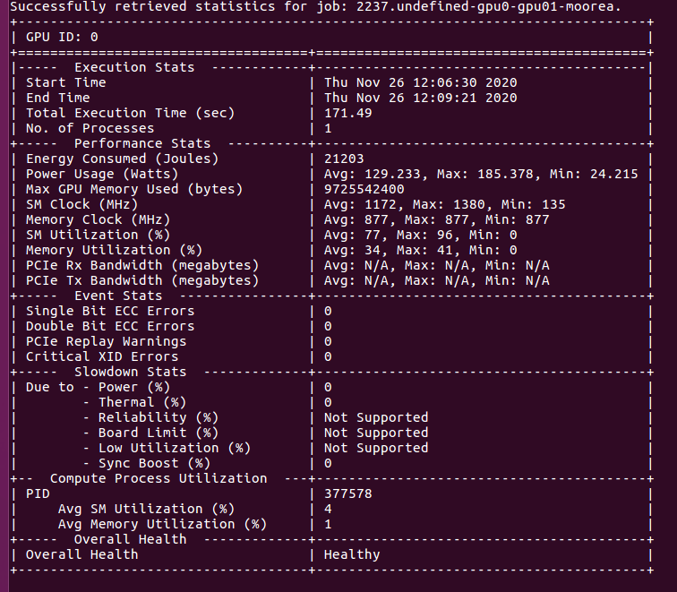
GPU Example

